Slide 1
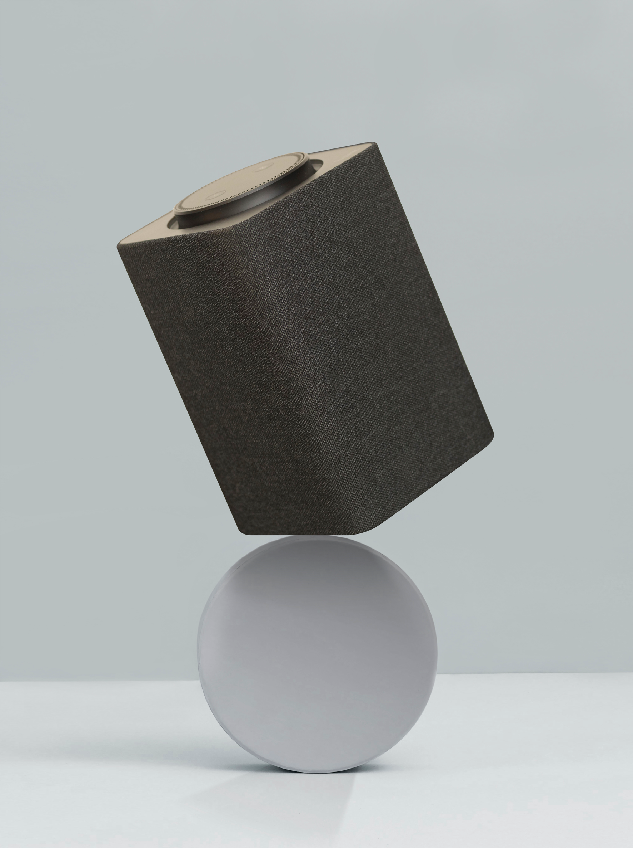

How-To-Marymount
Mary Chat chatMaryAi.co
Team 12
Hoya Hacks 2024

Slide 2
Features
03
01
02
04
Carbon Offset Calculator
Interactive
Form Submission
Club Selector

Slide 3


02
Features
Designer portfolio

Slide 4
Interactive
Personalized
Timely
Utilize MU-chat for personalized assistance.
Instant access to support for academic, administrative, and campus life queries.
Chatbot provides real-time responses and resources tailored to individual needs.

Slide 5

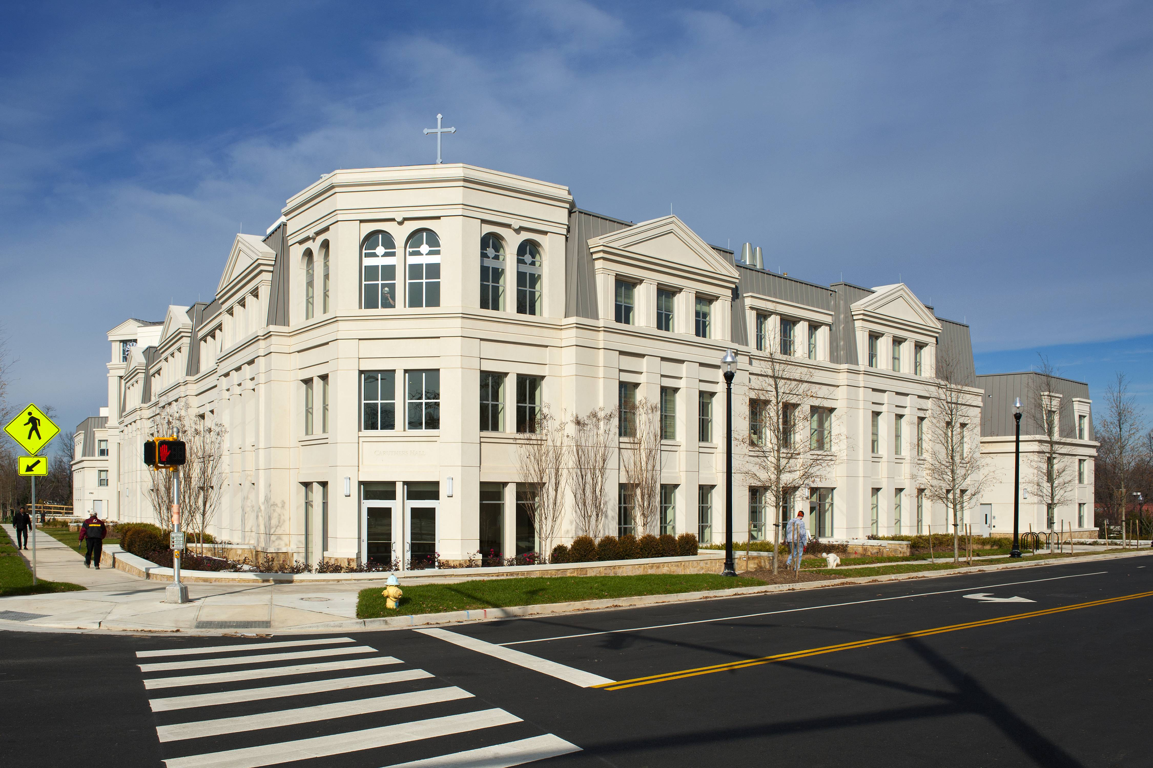

Diversity
Access to a variety of student organizations catering to different interests.
Enhance campus experience by joining clubs aligned with personal passions and backgrounds.

Slide 6
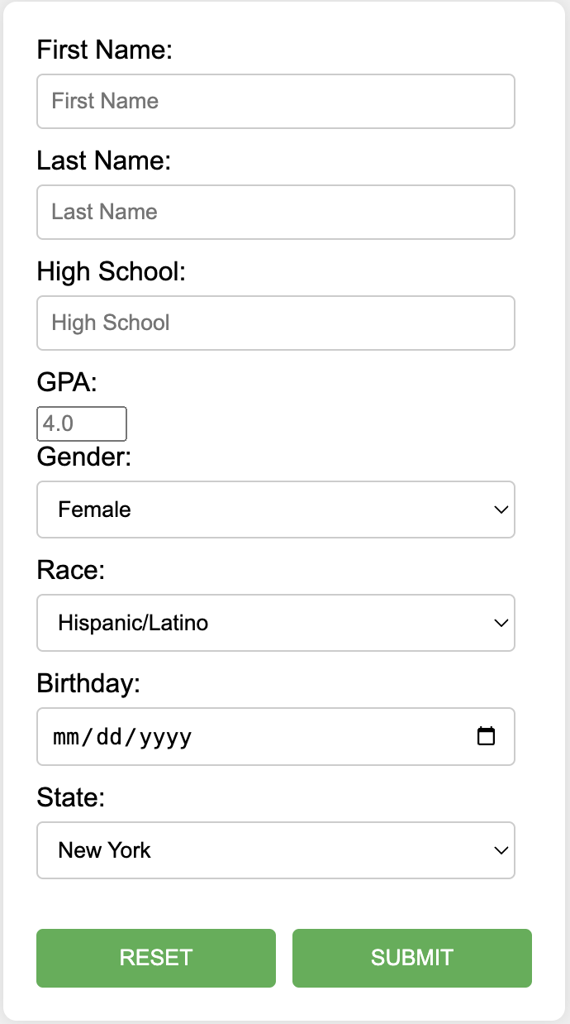
Form Submission
Provide essential information for tailored support.
User-friendly form captures crucial details for personalized assistance.

Slide 7
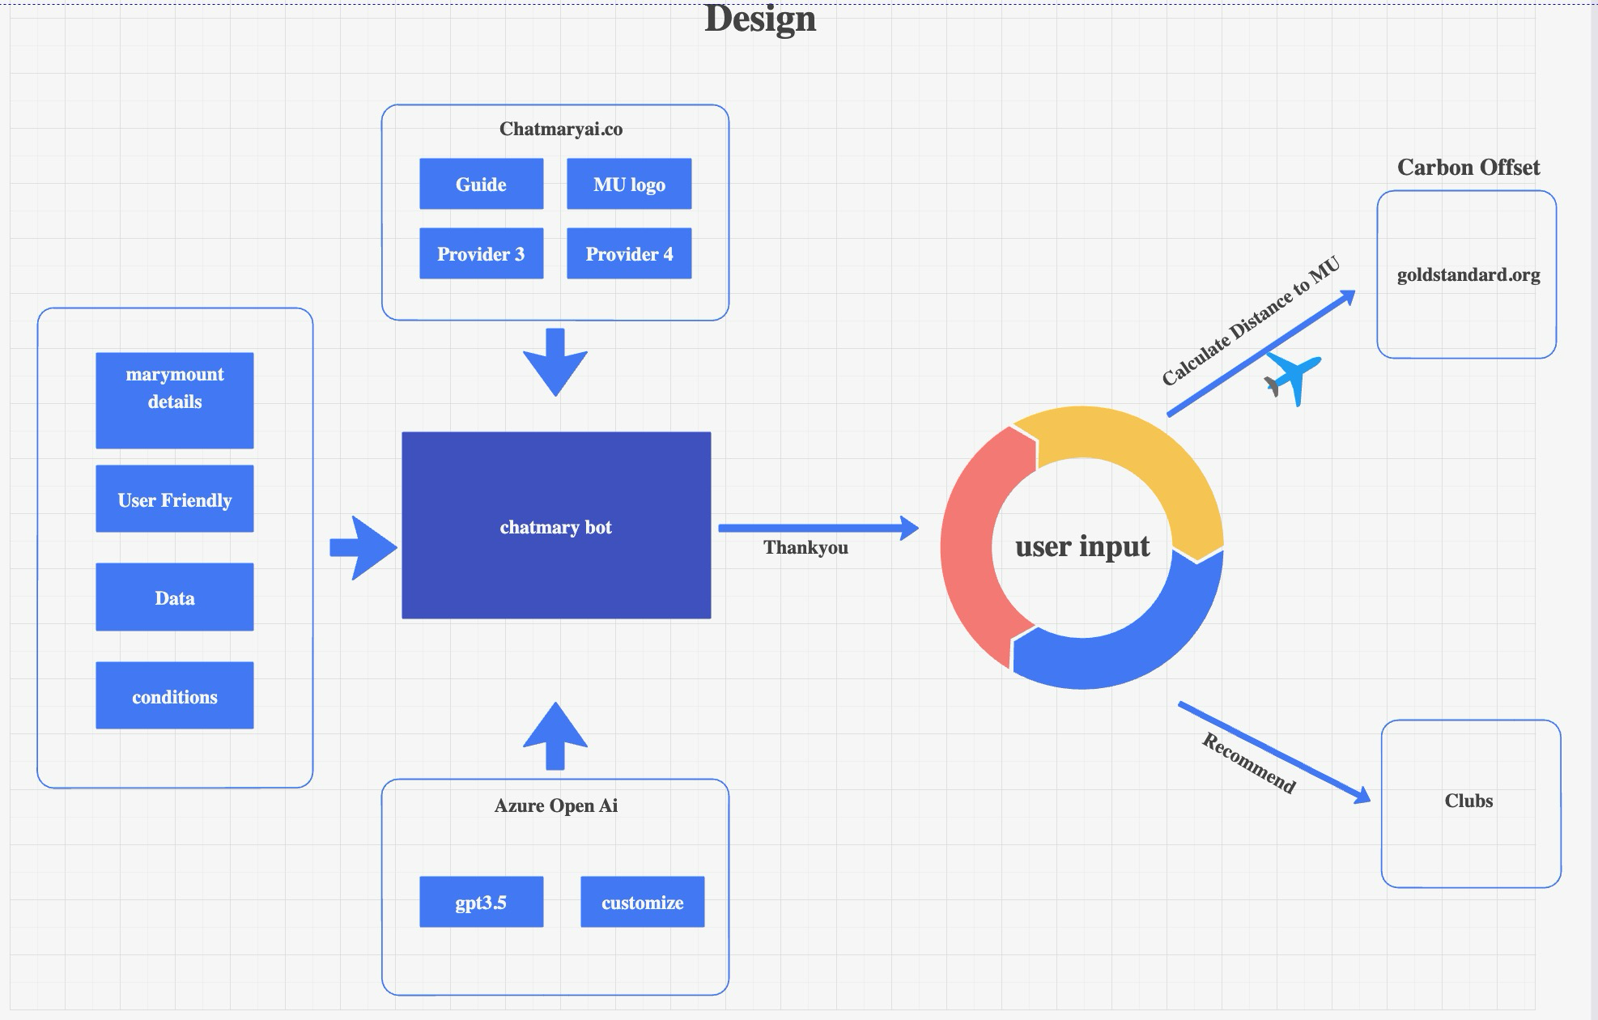
Architecture Diagram
Used industry standard prompts

Slide 8

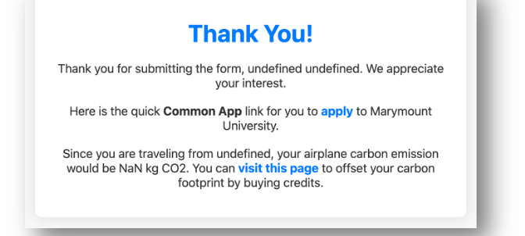
Climate Friendly
Calculate your carbon footprint based on travel from your state to Virginia.
Utilizes average distances and emissions data to estimate carbon emissions.
Provides insight into individual contribution to climate change.

Slide 9
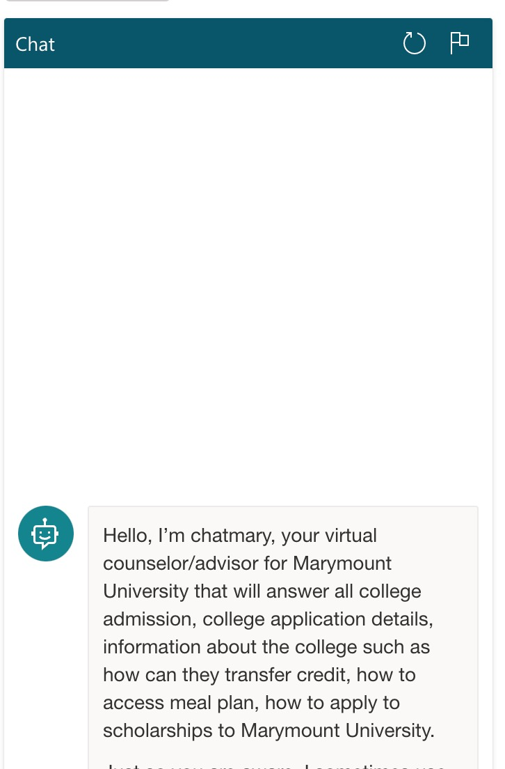
Friendly Interface
Used great UI/UX Elements

Slide 10
Call To Action
Visit chatmaryai.co
Start your journey with MU-chat now!

Slide 11
Thanks!
Team 12 Abhishek Nepal, Sneha Joshi, Ha Li Nguyen

